Slide 6
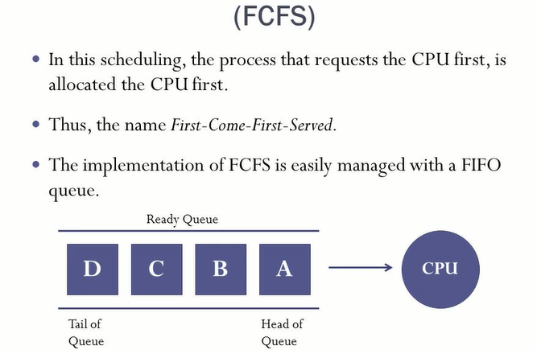

Slide 9
// C program for implementation of FCFS scheduling
#include<stdio.h>
// Function to find the waiting time for all processes
void findWaitingTime(int processes[], int n,
int bt[], int wt[])
{
// waiting time for first process is 0
wt[0] = 0;
// calculating waiting time
for (int i = 1; i < n ; i++ )
wt[i] = bt[i-1] + wt[i-1] ;
}
// Function to calculate turn around time
void findTurnAroundTime( int processes[], int n,
int bt[], int wt[], int tat[])
{
// calculating turnaround time by adding
// bt[i] + wt[i]
for (int i = 0; i < n ; i++)
tat[i] = bt[i] + wt[i];
}
//Function to calculate average time
void findavgTime( int processes[], int n, int bt[])
{
int wt[n], tat[n], total_wt = 0, total_tat = 0;
//Function to find waiting time of all processes
findWaitingTime(processes, n, bt, wt);
//Function to find turn around time for all processes
findTurnAroundTime(processes, n, bt, wt, tat);
//Display processes along with all details
printf("Processes Burst time Waiting time Turn around time\n");
// Calculate total waiting time and total turn
// around time
for (int i=0; i<n; i++)
{
total_wt = total_wt + wt[i];
total_tat = total_tat + tat[i];
printf(" %d ",(i+1));
printf(" %d ", bt[i] );
printf(" %d",wt[i] );
printf(" %d\n",tat[i] );
}
int s=(float)total_wt / (float)n;
int t=(float)total_tat / (float)n;
printf("Average waiting time = %d",s);
printf("\n");
printf("Average turn around time = %d ",t);
}
// Driver code
int main()
{
//process id's
int processes[] = { 1, 2, 3};
int n = sizeof processes / sizeof processes[0];
//Burst time of all processes
int burst_time[] = {10, 5, 8};
findavgTime(processes, n, burst_time);
return 0;
}

Slide 13
class SGFG {
static int[][] mat = new int[10][6];
static void arrangeArrival(int num, int[][] mat)
{
for (int i = 0; i < num; i++) {
for (int j = 0; j < num - i - 1; j++) {
if (mat[j][1] > mat[j + 1][1]) {
for (int k = 0; k < 5; k++) {
int temp = mat[j][k];
mat[j][k] = mat[j + 1][k];
mat[j + 1][k] = temp;
}
}
}
}
}

Slide 17
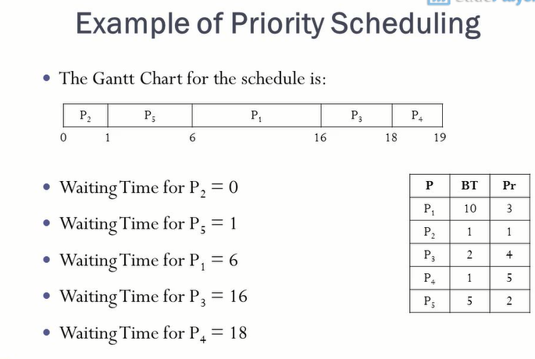

Slide 18
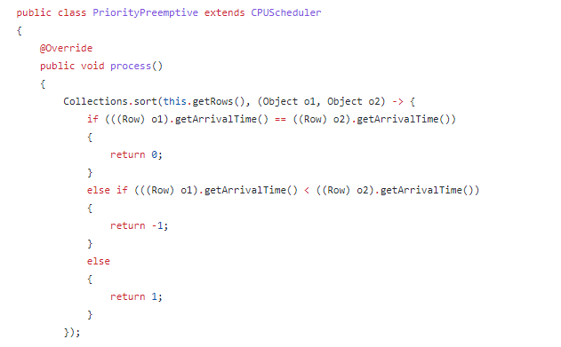

Slide 25
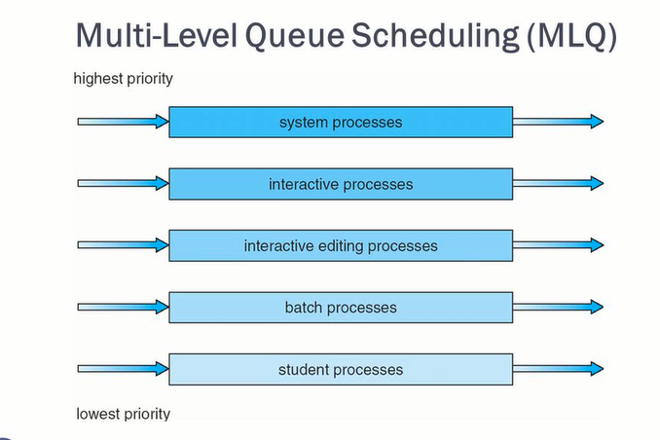

Slide 28
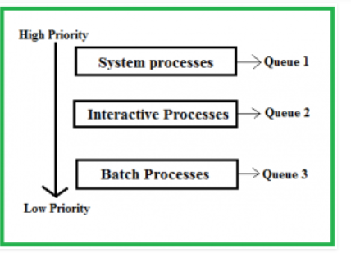

Slide 29
Usama Saleem
FA19-BSCS-0046

